Slide 1
Powershell Basics
Batch files are so 1990’s
Thomas Gardner

Slide 2
What We’ll Cover
BACKGROUND
It’s on fleek, SON!
SCRIPTING IN POWERSHELL
What’s a cmdlet?
EXECUTION POLICY
Those nasty permissions!
BYPASSING EXECUTION POLICY
Making the last slide pointless…
INTERFACING WITH WINDOWS THROUGH WMI
This is where (some of) the magic happens

Slide 3
Background
Originally created for Windows system administration
Intended to be both fully scriptable and interactive
Built on top of Microsoft’s .NET framework
Officially released in 2006 (formerly called Monad)
Notes:
Released in 2006 according to Wikipedia…

Slide 4
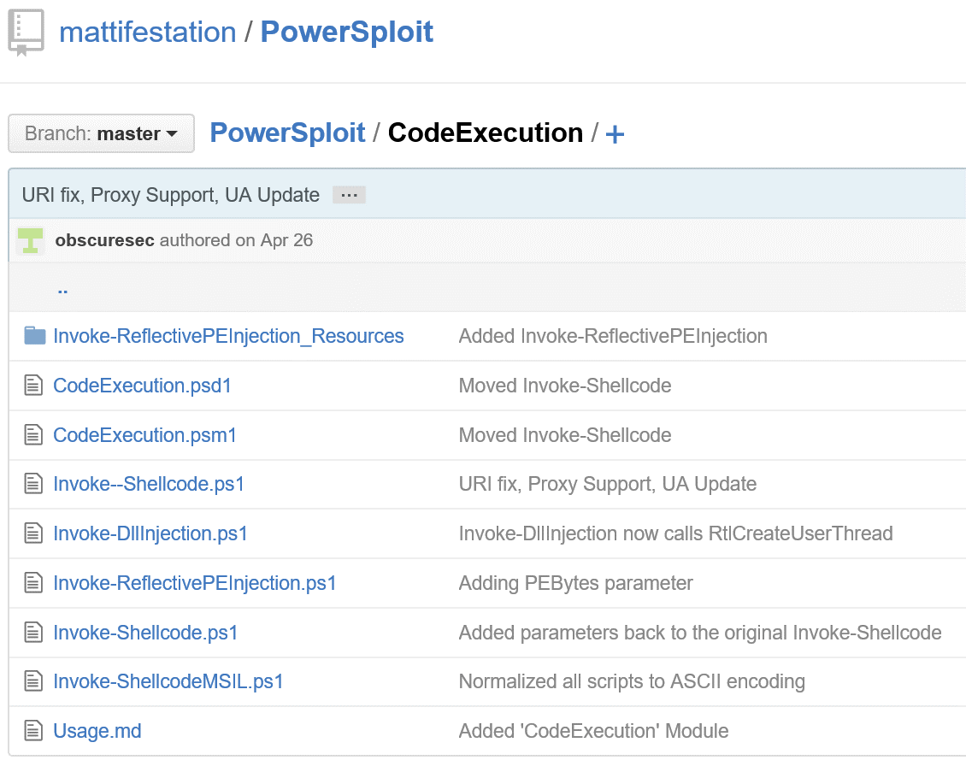
Scripting in powershell
Original purpose is automation
Object-oriented language
Cmdlets: Building block of PS scripts
Compiled .NET code
Work like tools in other shells
Modules allow PS to be extended with custom code
For good or bad purposes!
.ps1 -> script
.psm1 -> module
.psd1 -> data
Notes:
Image: PowerSploit, a PowerShell version of the popular Metasploit Framework for post-exploitation in Windows

Slide 5
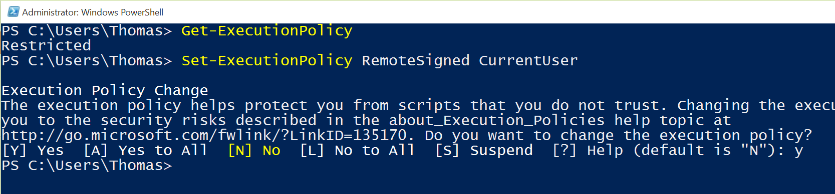
Execution policy
Microsoft’s answer to UNIX’s READ-WRITE-EXECUTE permissions
Also generally the first obstacle to executing scripts!
Options for:
Certificate Usage (AllSigned, RemoteSigned)
Foreign scripts (RemoteSigned)
All Or Nothing (Restricted, Unrestricted)
Get-ExecutionPolicy
(Get-ItemProperty 'HKCU:\Software\Microsoft\PowerShell\1\ShellIds\Microsoft.PowerShell' ExecutionPolicy).ExecutionPolicy

Slide 6
Execution Policy bypass Nothing HackerY yet, that’s next month
Persistent Mode:
Define the Execution Policy for your user
Type Set-ExecutionPolicy <level> in a PowerShell terminal
Unrestricted: ANY script can run
RemoteSigned: Any LOCAL script can run
Problem: Requires Admin access
Read File Mode:
Read content in to a new PowerShell process
Get-Content <script> | PowerShell.exe –nop -
Get-Content reads a file into memory
| PowerShell.exe sends the file content to PowerShell
-nop – means no ExecutionPolicy is set to block the script
Powershell.exe –executionpolicy bypass –File <script>
Problem: Cannot interact with script

Slide 7
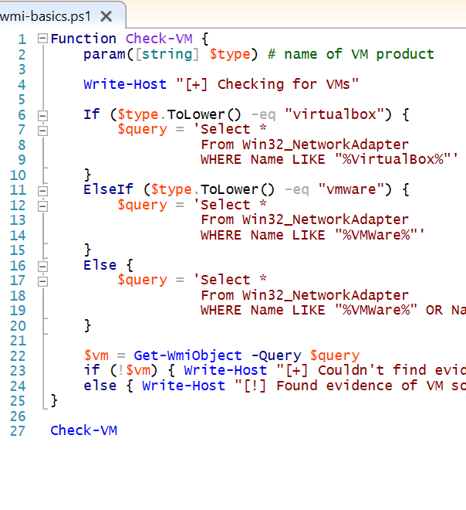
Interfacing with WMI
Windows Management Interface
Set of tools for interfacing with OS internals
Event logs, network interfaces, processes, and much more!
System admins and malware authors commonly use these techniques
Getting running processes is a useful technique for both
Checking for the presence of VMs is more specific to malware…
New methods are constantly being developed
“Abusing Windows Management Instrumentation (WMI) to Build a Persistent, Asyncronous, and Fileless Backdoor” by Matt Graeber (Black Hat 2015)

Slide 8
Resources & Citations
Windows PowerShell Overview
Creating PowerShell cmdlets
Cmdlets Cheat Sheet
Introduction to PowerShell Modules
“Abusing Windows Management Instrumentation…” by Matt Graeber

